Slide 1
The Control System
All those cool looking wires and boxes

Slide 2
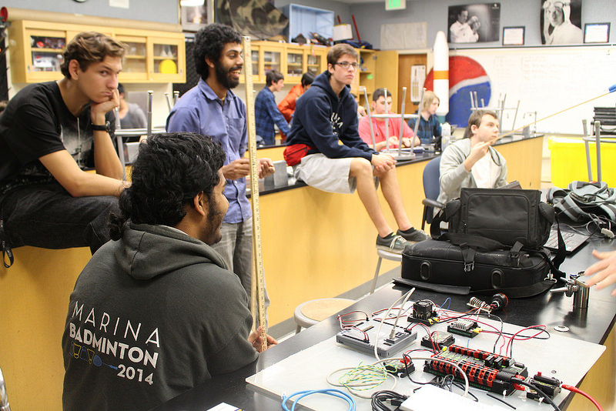
Hey MJ, what’s a control system?
The thing that turns button presses into moving robot.
All FIRST control systems must have certain key components.
Basic understanding of how they are connected.
Basic testing control system setup ^

Slide 3
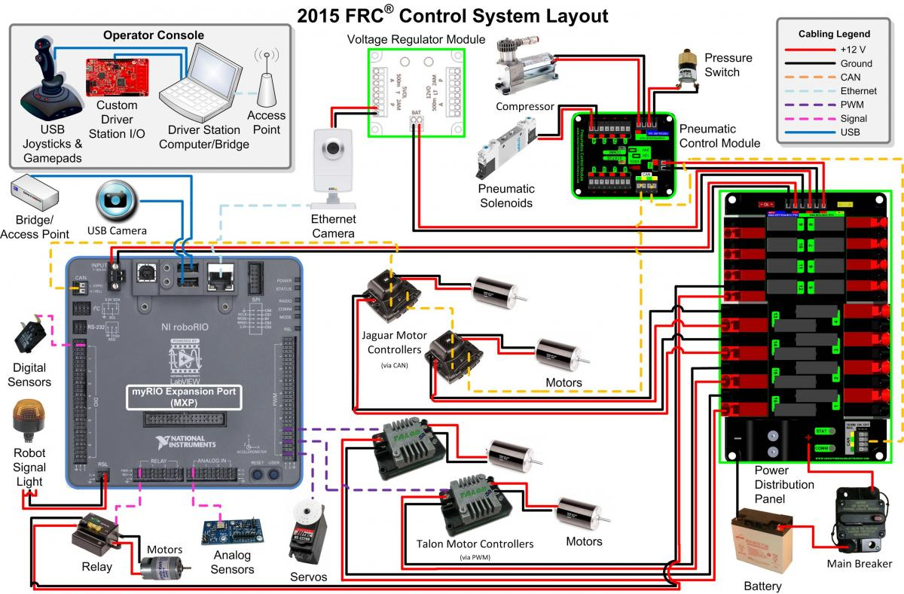
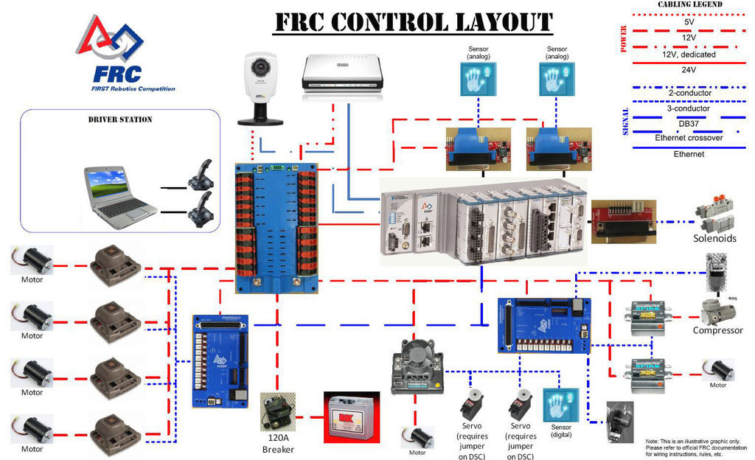
New v.s. Old
Old Junk:
Fancy New Junk:

Slide 4
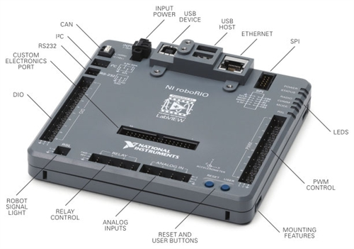
The BRAIN!
Know what some of those pins mean.
Important things:
Ethernet
Power Input
PWM Ports
Analog Ports
Reset Button
RSL (Robot Signal Light)
DIO (Digital Input/Output)
CAN
Stores and executes the robot code
Connected to everything else on the robot

Slide 5
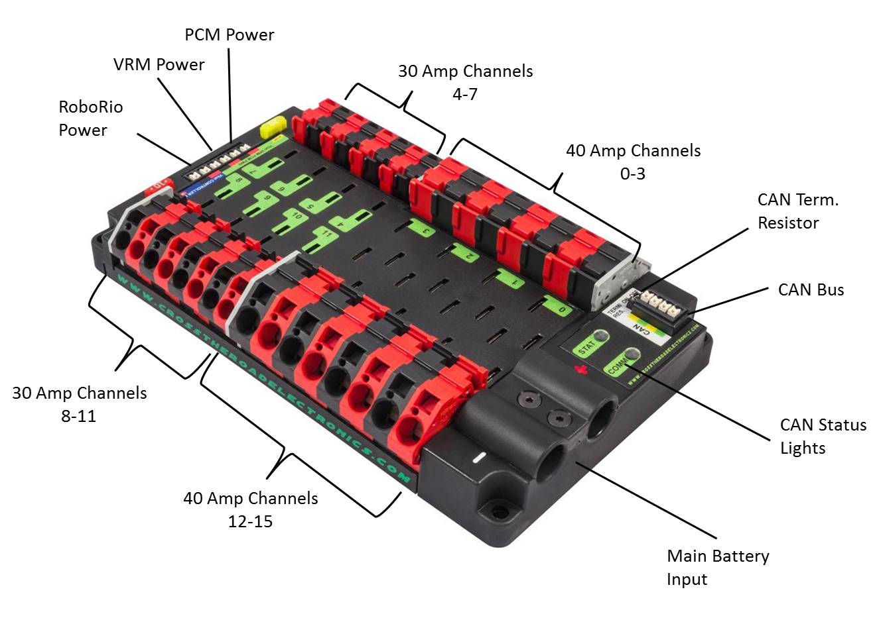
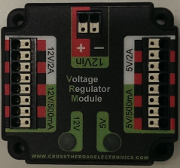
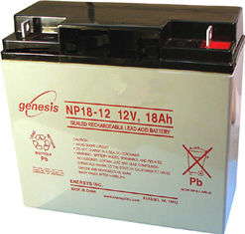
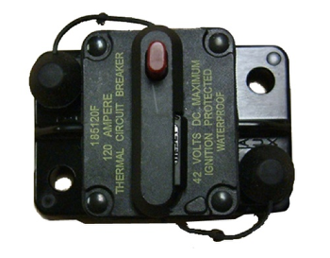
We need more power!
Power for the robot is provided by a 12 volt motorcycle battery
All power is distributed through the PDB (Power Distribution Board)
The board has special ports for key components, such as the RoboRio and the VRM (voltage regulator module)
The robot can be shut down at any time by triggering the main breaker (that cool red button)

Slide 6
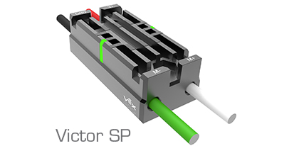
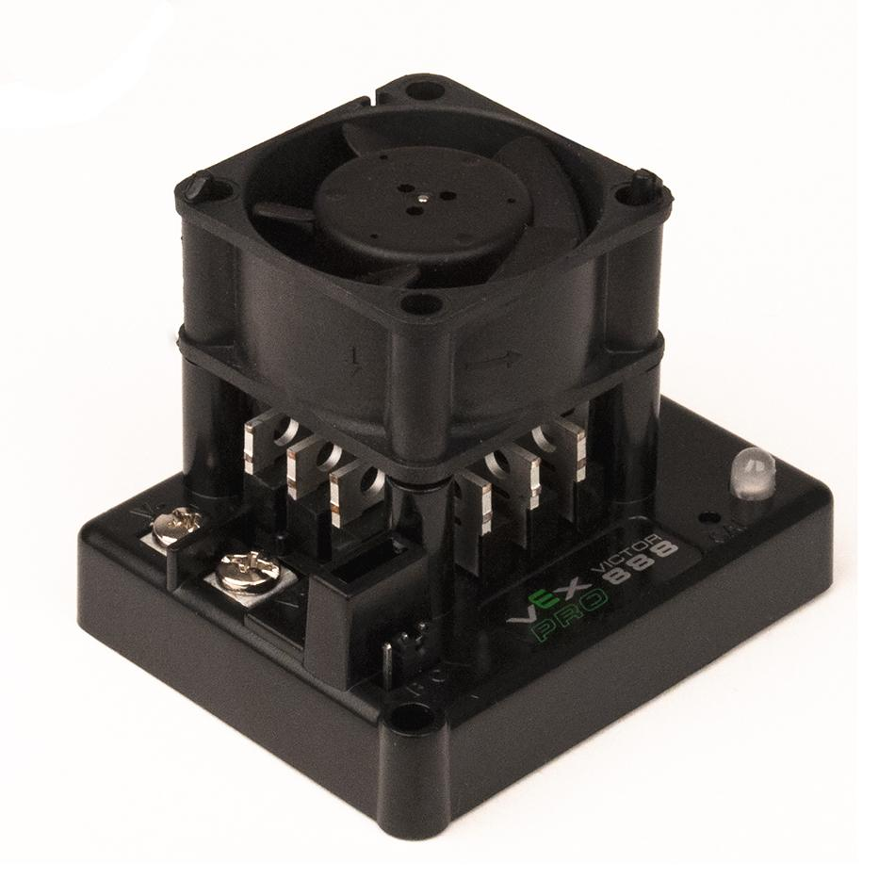
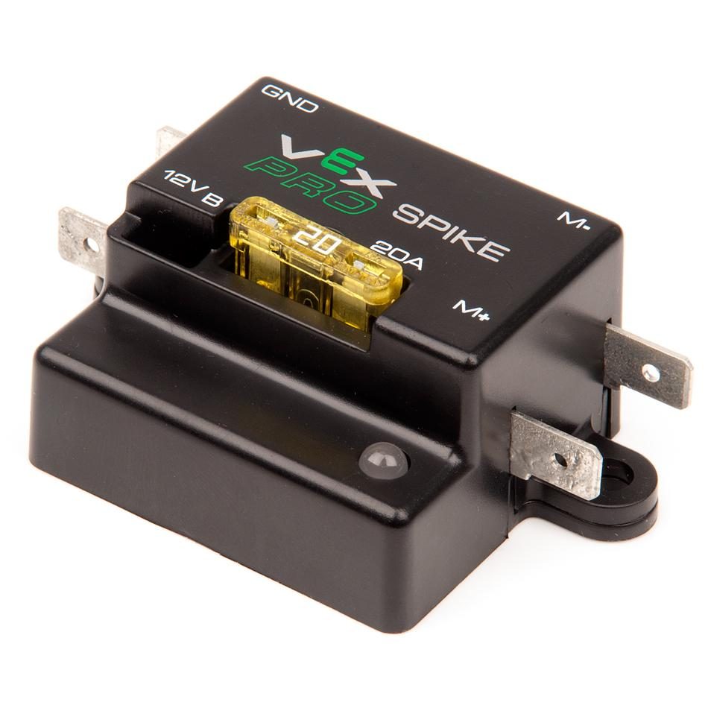
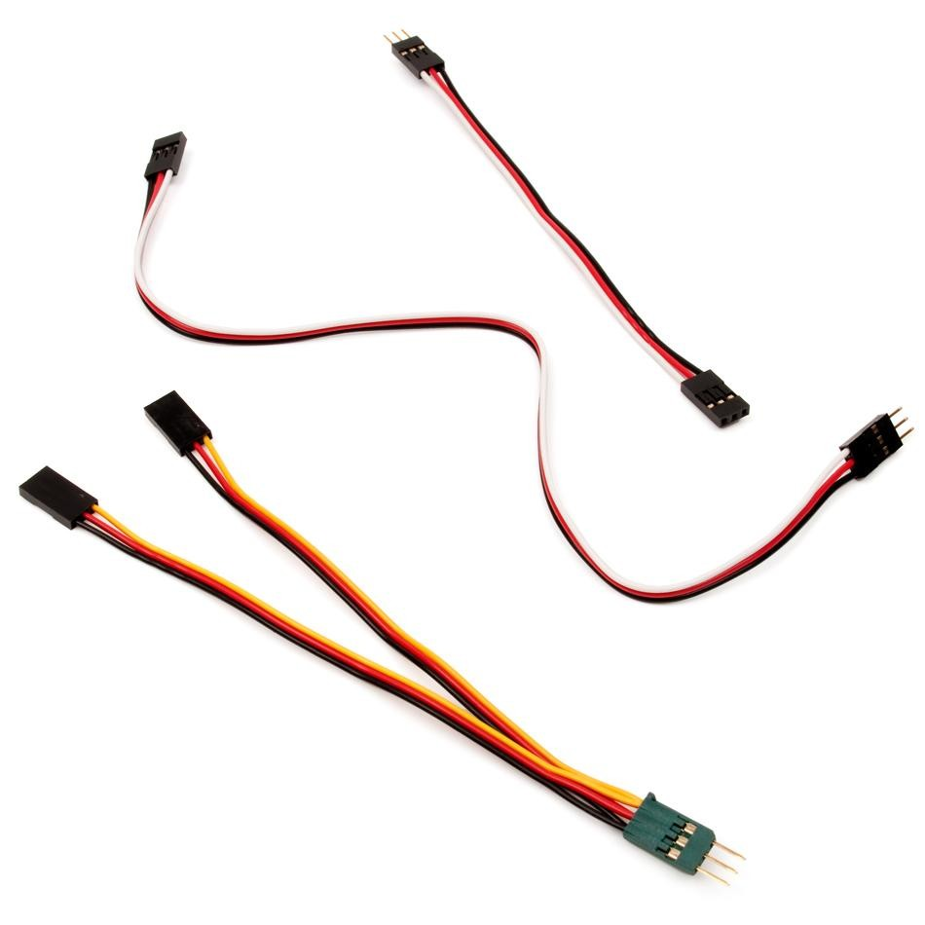
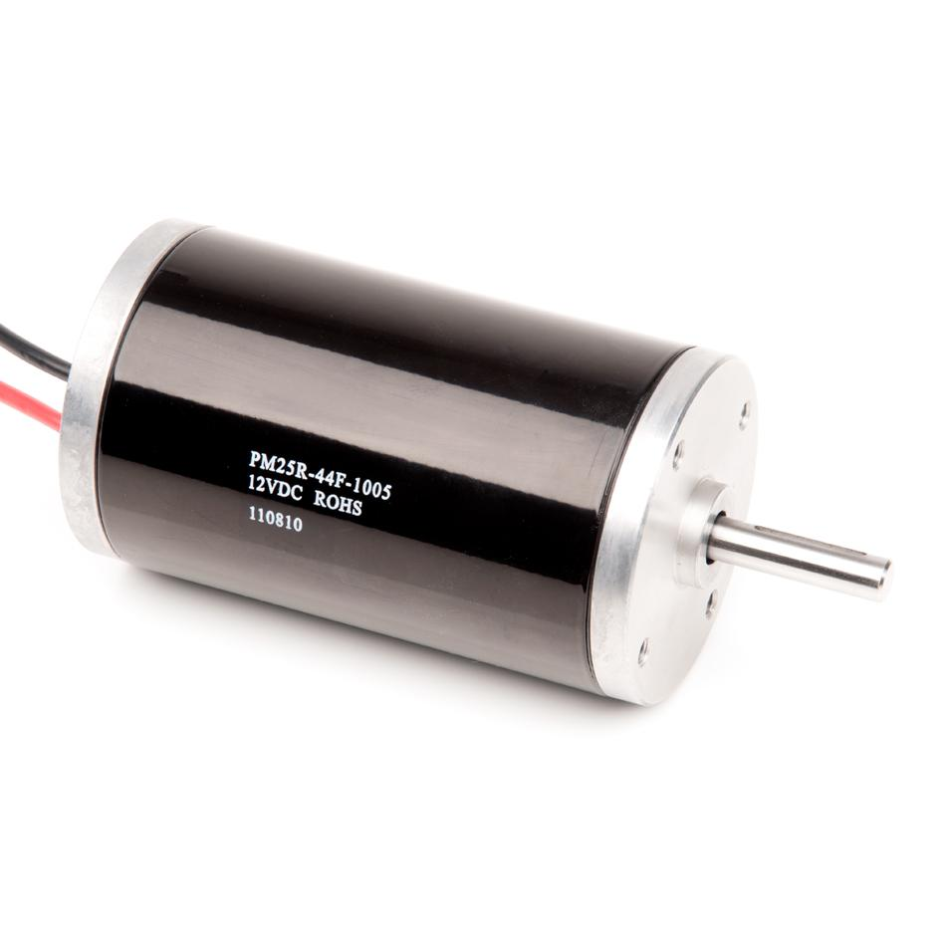
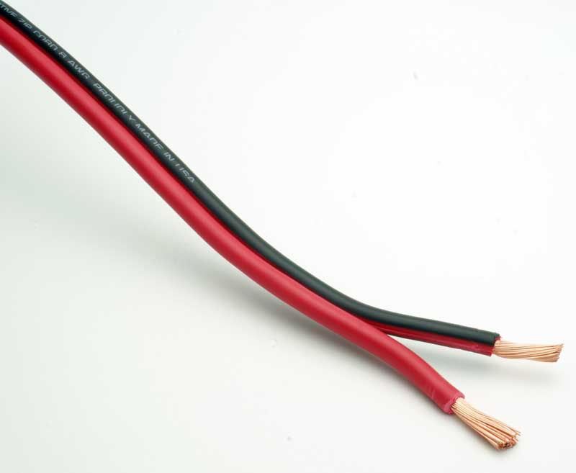
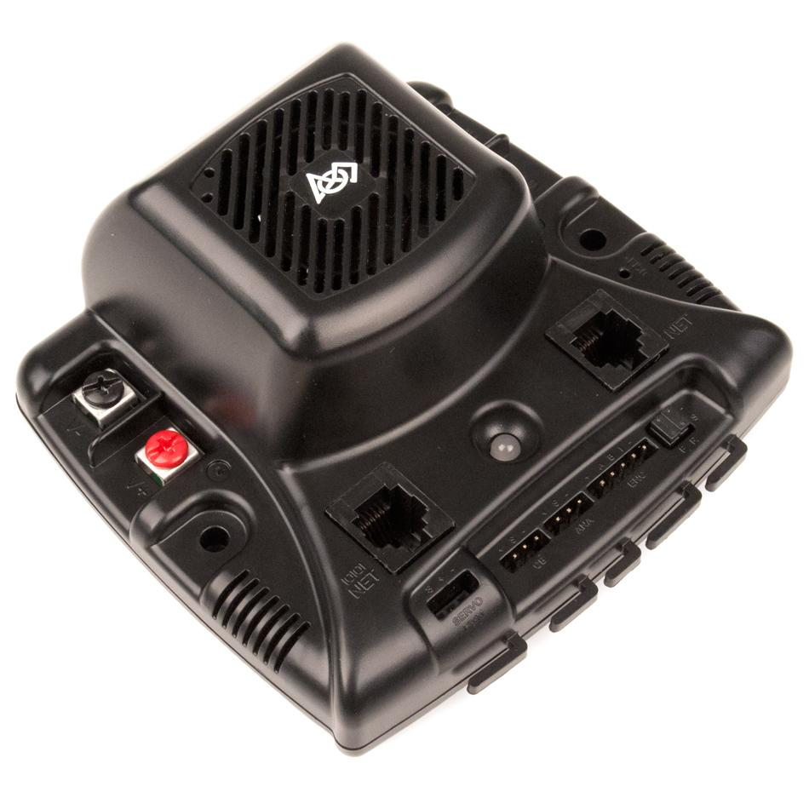
Open The Floodgates!
RoboRio can only send low-voltage signals; many components require more power to function
Speed Controllers and Relays read a low-voltage signal from the RoboRio and “open the floodgates”, allowing power from the PDB to flow to a component
Relays: On/Reverse/Off;
Speed Controllers: anywhere in between
PWM (Pulse Width Modulation): not as complicated as it sounds

Slide 7
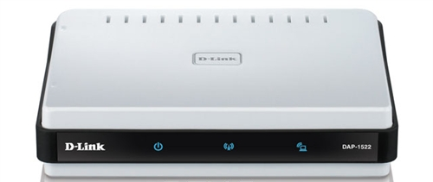
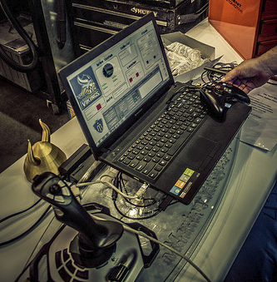
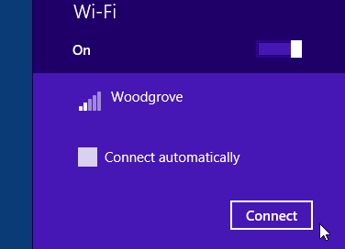
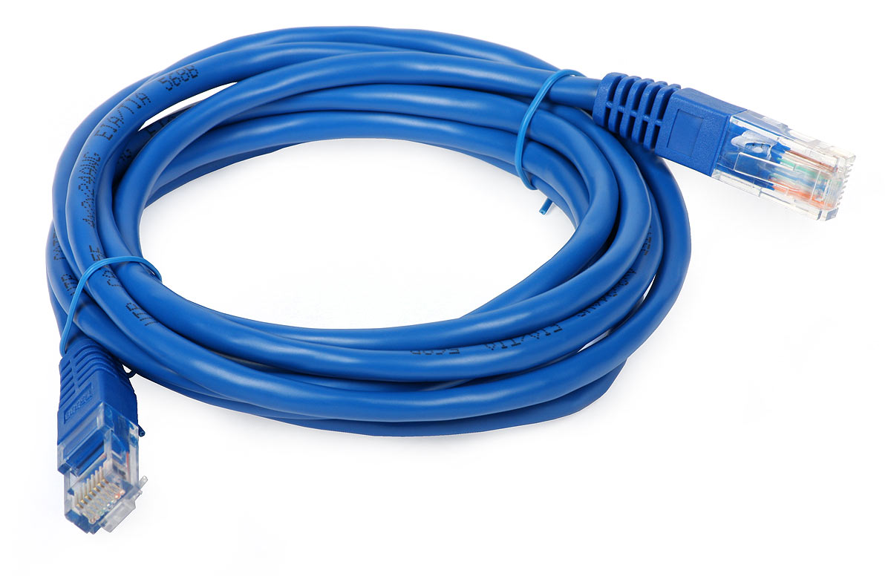
But wait, MJ, how does the robot know what buttons I’m pressing?
The radio! (a wifi router)
The driver station connects to this router and communicates with it, sending and receiving information
It’s connected to the RoboRio via Ethernet cable
MAKE SURE IT IS PLUGGED IN
4276

Slide 8
Let’s have a look at some of the components!
Hopefully future me has taken the liberty of acquiring some hardware to pass around.
When an interesting component reaches you, make the appropriate expression of awe as you are struck by the wonder of modern technology.
If future me has not acquired said hardware, please stand, give him a scornful glare of contempt, and silently file out of the room.
Most Importantly:
Ask Questions!

